Slide 1
Canada Post Order Tracking Chatbot
December 13, 2023
Student Name: Ling Lin
Student Id: 301292283
Notes:
Hi profesor, my name is ling lin. My project topic is about canada post order tracking chatbot.

Slide 2

Introduction
Efficient Order Tracking Support for Canada Post Customers
postgrid.com
Notes:
Let me introduce it. This chatbot is designed for one primary purpose - to simplify the process of checking order statuses with Canada Post. It does this by swiftly recognizing user queries and responding promptly with accurate information.

Slide 3

Project Overview
Functional Requirements
Tracking orders
recognizing specific patterns
handling inquiries
providing exit functionality
Chatbot Features
Recognizing order numbers
Handling greetings
Tracking inquiries
Implementation Details
Python NLTK library
regular expressions
intuz.com
Notes:
Let's delve into the essential functional aspects of our chatbot: This chatbot’s main functional requirements including tracking Tracking orders, recognizing specific patterns, handling inquiries, providing exit functionality. It is implemented by Python NLTK library and regular expressions for natural language processing. And the chatbot features are recognizing order numbers, handling greetings, and tracking inquiries.

Slide 4
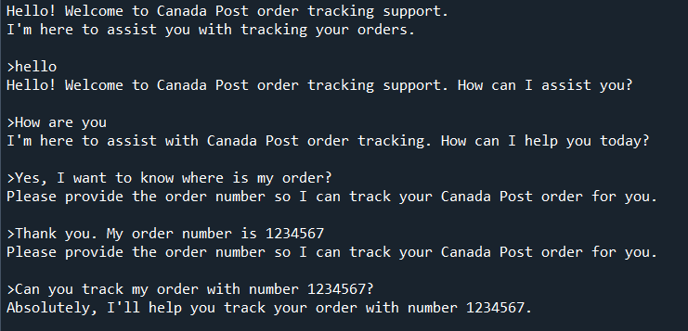
Order Tracking Chatbot
Notes:
This is part of the order tracking chatbot conversation. Let me show to you.

Slide 5

slideshare.net

